Slide 1
image recognition
An introduction

Slide 2
Since the sixties: ‘computer vision’
Making computers understand images

Slide 3
History
Earlier days: set of rules and instructions
Nowadays: deep learning from database

Slide 4
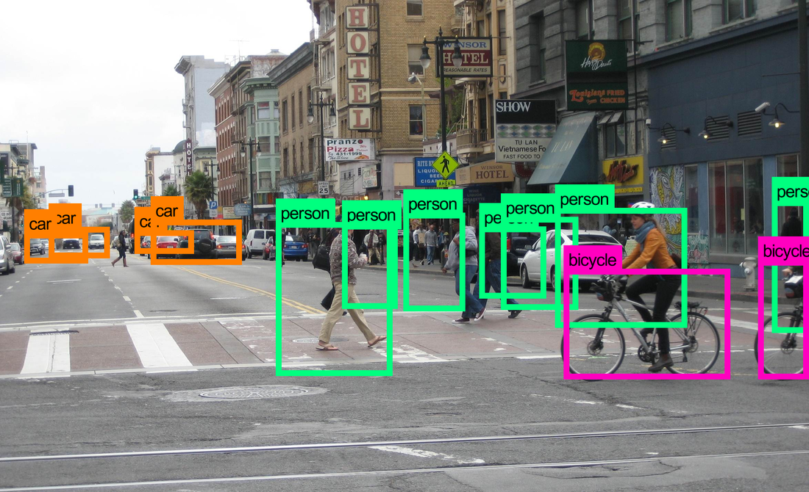
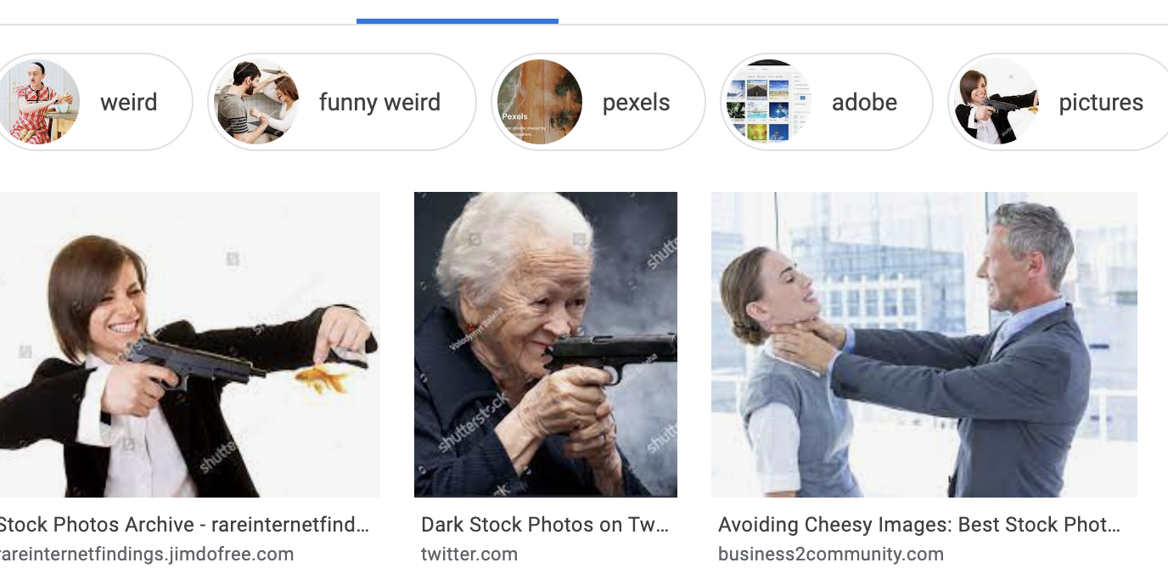
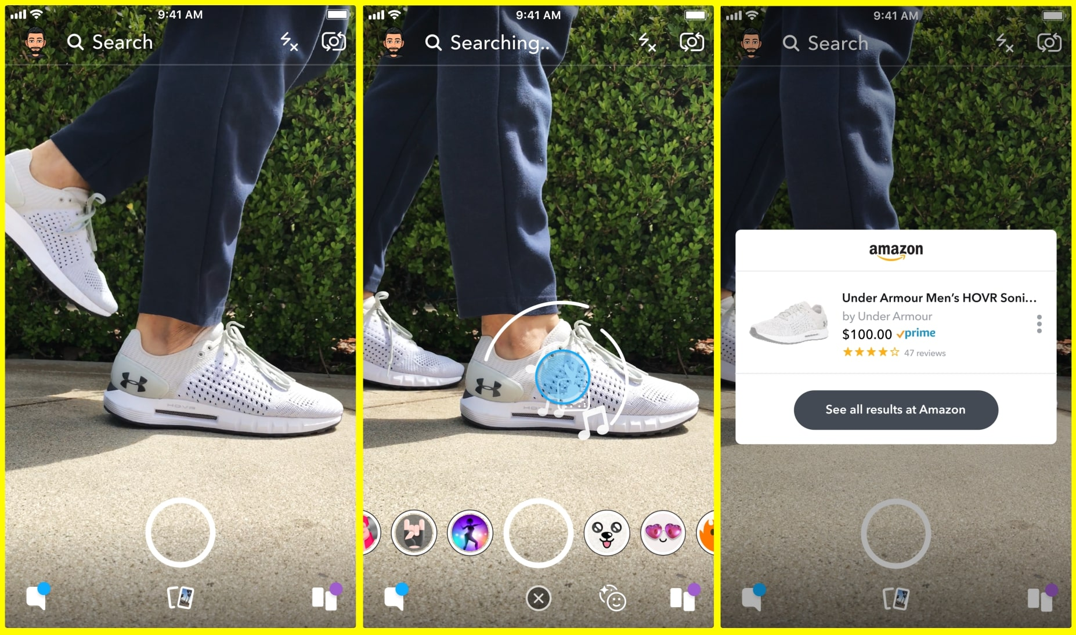
Top 5 uses
Automated image organization
Stock photos and videos
Visual search
Image classifications
Social networks

Slide 5
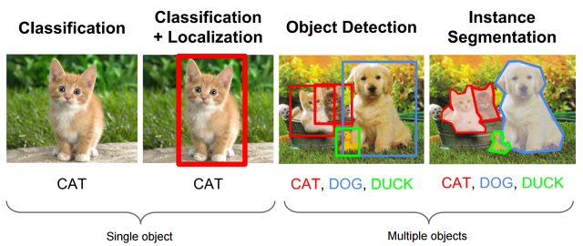
What does your computer ‘learn’?
Classification and tagging
Detection and segmentation

Slide 6
Classification and tagging
‘Ontology’: teach the algorithm classes of objects
Classification for one object
Tagging for multiple objects

Slide 7
Detection and segmentation
Location of the objects
Detection finds the bounding box
Segmentation maps by pixel (e.g. cancer detection)

Slide 8
… and more
Pattern recognition
Audio recognition (Shazam)
Picture description

Slide 9
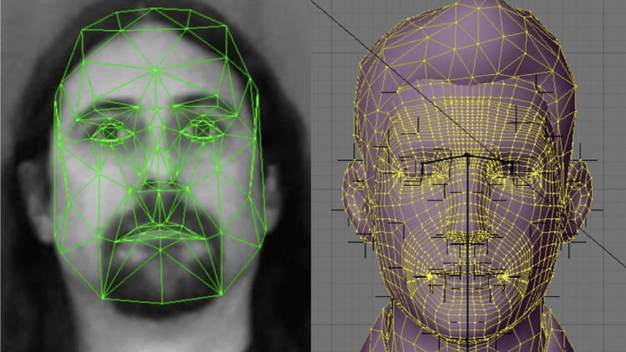
Basically …
Input = digital image = set of points
Remove noise
Definition of a set of features (coordinate axes)
Classification (closeness of certain points)
Recognition and decision making

Slide 10
Algorithms
Minimal distance methods
Statistical methods
Neural network methods

Slide 11
Where are we Now?
Towards Data Science:
“Train Image Recognition AI with 5 lines of code”

Slide 12
Try it yourself
https://towardsdatascience.com/train-image-recognition-ai-with-5-lines-of-code-8ed0bdd8d9ba

Slide 13
Q&A …
… and thank you for your attention!

Slide 14
Sources
As found on the web on 23/06/2021
https://imagga.com/blog/the-top-5-uses-of-image-recognition/
https://deepomatic.com/en/introduction-to-computer-vision-and-image-recognition
https://medium.datadriveninvestor.com/introduction-to-image-recognition-d104bdf7018b

